Slide 1
Superintendent’s Report Orange Public Schools “Good to Great”
Gerald Fitzhugh, II, Ed.D.
Superintendent of Schools
“ The Teaching Superintendent”
June 14, 2023
Focus Core Area Numbers 1- 4
District Goal Number 1-4 and All Sub Sections

Slide 2
Scholarships Update
Gerald Fitzhugh, II, Ed.D.
Superintendent of Schools
“ The Teaching Superintendent”
June 14, 2023
Focus Core Area Numbers 1 & 2
District Goal Number 1&4 and All Sub Sections

Slide 3
Scholarship Update as of June 2023
This past week, I requested scholarship totals for the Orange High School and STEM Innovation Academy of the Oranges. As shared previously, I will report out on scholarships, so the community and Board of Education are very much aware of information in real time.
OHS-$10,235,325 (As of April 12th)
STEM-$13,080,561 (As of April 12th)
OHS-$14,641,700 (As of May 2nd)
STEM-$18,878,802 (As of May 2nd)
OHS-$16,084,512 (As of June 14, 2023)
STEM-$19,625,602 (As of June 14, 2023)
Total as of April 19, 2023: $23,315,886.00
Total as of May 10, 2023: $33,520,502.00
Total as of June 14, 2023: $35,710,114.00
Congratulations thus far to the Class of 2023 as well as our guidance, instructional, and administrative staff members for working so diligently with our scholars.
Last year, we amassed over 26 million dollars in scholarships district wide. We are well on our way….More to come!

Slide 4
Celebration of Staff Retirements and 25 Years of Service
Ms. Glasshebra Jones
Executive Director of Human Resources
June 14, 2023

Slide 5
2023 RETIREES
Emily Quaye – School Nurse - 12 Years of Service
Judith Powell – School Nurse – 18 Years of Service
Regina Price – Administrative Secretary - 18 Years of Service
Marietta Bond – Administrative Secretary - 20 Years of Service
Laura Sacks – School Nurse - 23 Years of Service
Ruth Louissant-Casimir – Paraprofessional - 35 Years of Service
Sonya Tynes – Educator – 39 Years of Service

Slide 6
25 Years of Service
Faith Alcantara – Executive Director of Innovation & Community Engagement
Jerome Arnold – Security Officer
Susan Battle – Paraprofessional
Laura Bautista – Spanish Teacher
Sheila Caraway – Security Officer
Troy S. Fisher – Security Officer

Slide 7
25 Years of Service
Lisa A. Jefferies-Simon – Paraprofessional
Genora Jenkins – Paraprofessional
Sherri Mann – Security Officer
William “Bill” Nussbaum – Educator
Edwin Jesus “EJ” Vasquez – Manager of Security

Slide 8
Celebration of Students Student of the Month Announcement
Gerald Fitzhugh, II, Ed.D.
Superintendent of Schools
“ The Teaching Superintendent”
June 14, 2023
Focus Core Area Numbers 1 & 2
District Goal Number 1&4 and All Sub Sections

Slide 9
Students of the Month May 2023 Congratulations to our STAR Students!
Name of School | Student of the Month
Orange High School | Jennifer Inamagua
Orange Preparatory Academy of Inquiry and Innovation | Amira Gordon
Twilight U | Camilla Arriola
Cleveland Street School | Emerey Gibbs
Forest Street School | Yadira Dolores-Jimenez
Heywood Avenue School | Lucas Aran
Name of School | Student of the Month
Lincoln Avenue School | Nayeli Figueroa
Oakwood Avenue School | Ashley Morocho
Rosa Parks Community School | Brandon Butler
Park Avenue School | Jaimie Glaude
STEM Innovation Academy of the Oranges | Tyseyone Zelelew
Central Elementary School | Shamir Drinkard

Slide 10
NJDOE Equivalency (Instruction and Programs) Gerald Fitzhugh, II, Ed.D., & Tina Powell, Ed.D.
District Goal 1/Core Focus Area 4 (Advance the use and management of a multi-faceted district-wide assessment system that is aligned to curricula, integrates multiple measures, and allows accessibility and modifications, and that acts as a continuous thread of instructional practice)

Slide 11
Why the Equivalency in Instruction and Programs? Accountability Overview and Federal Waivers
School accountability under the Every Student Succeeds Act (ESSA) is just one of the New Jersey Accountability Measures in order to improve student access to high quality education programs.
Cohort 1 School District that are mandated to go through NJQSAC have the opportunity to utilize the waiver.
It is important to note: New Jersey received such waivers from the United States Department of Education in both March 2020 as well as March 2021. To add, under these waivers, the New Jersey Department of Education did not calculate indicator scores or summative scores, measure progress toward long term goals, or identify or exit schools for support or improvement for the 2019-2020 and 2020-2021 school years.
Moving in 2021, under the March 2021waiver, states were required to resume identifying schools for support and improvement in the fall of 2022 based on 2021-2022 test data.
Reminder: New Jersey did not conduct the NJSLA since the Spring of 2019 until this past Spring (2022).

Slide 12
Why the Equivalency in Instruction and Programs? Accountability Overview and Federal Waivers
Student Growth Percentiles (mSGP’s) have not been calculated since SY 2018-2019 due to the cancellation of statewide assessments for the following years: 2019-2020 and 2020-2021.
The equivalency will be used as a substitute in the area of Instruction and Program as part of the NJQSAC evaluation which utilized data from the NJSLA from 2018-2019 SY (prior to the pandemic). Why? The data from that time period are not reflective of current population and growth.
Growth should be measured using 2020-2021 and 2021-2022 measures due to the absence of state and federally mandated mSGP in 2021 and 2022. The district will utilize ELA: Insight at the secondary level and SRI assessment at the 3-7 and in the area of mathematics, Iready Grades 3-8 and the NWEA Assessment Grades 9-12 from 2020-2021 and 2021-2022 to determine the growth of our students. This is our belief in the best interest of our dedicated staff and students.

Slide 13
METHODOLOGY (2020- 2021 & 2021 -2022 Data)
The COVID-19 pandemic created a number of challenges that interrupted our typical instructional programs (school closures due to outbreaks, etc.)
The district issues online diagnostic assessments each year in Mathematics and ELA to all K – 12 students. These assessments provide the district with metrics for getting individualized student growth goals and for identifying the needs for targeted supports. The district also contracts with a 3rd party data and research company to aid in the overall analysis of district diagnostic data.
In Mathematics Grades 3 - 8, iReady's Diagnostic Assessment is used to measure student progress/growth using iReady's performance measure. In Algebra I, Algebra II, and Geometry, the NWEA MAP Assessment is used to measure student progress/growth using a RIT score. Both diagnostic assessments are norm-referenced, standardized achievement tests reporting student growth over time.
In ELA Grades 3 - 8, Growth Measure is used to measure student progress/growth; reporting in Lexile levels. In Grades 9 - 10, Insight is used to measure student progress/growth; reporting in Lexile levels. The scores reflect scale scores.

Slide 15
METHODOLOGY (2019-2020 and 2020-2021)
The COVID-19 pandemic created a number of challenges that interrupted our typical instructional programs (school closures due to outbreaks, etc.)
The district issues 3 online diagnostic assessments each year in Mathematics and ELA to all K – 12 students. These assessments provide the district with metrics that help us set individualized student growth goals and identify targeted supports. The district contracts with a 3rd party data and research company to aid in the overall analysis of district diagnostic and interim data.
After making the necessary participation rate adjustments, we calculated the number of points earned by calculating the district’s NJQSAC Proficiency Rate by combining 50% of the NJQSAC Proficiency Rate derived from the District's proficiency rate for "all" students and 50% of the NJQSAC Proficiency Rate derived from the average Student Group rate; then finally multiplying by 7.5, the district’s possible point total for Mathematics & ELA. The final score was derived from averaging the 2019-2020 and 2020-2021 final point calculations.

Slide 17
District Goals for SY 23-24
Gerald Fitzhugh, II, Ed.D.
Superintendent of Schools
“ The Teaching Superintendent”
June 14, 2023

Slide 18
District Goal #1: 21st Century Integration
Overarching Overview of the Goal
Goal #1: 21st Century Integration
The Orange Public Schools will continue to invest in its teachers. The district values and promotes a culture of excellence in teaching and learning through increased and improved opportunities for quality, sustained professional development that address district needs and individual school needs as outlined by data points. The emphasis has been on best practices in teaching and learning. As a result of the pandemic and performance on assessments, a continued understanding of providing targeted and intentional delivery of instruction is paramount district-wide while keeping in mind how to integrate technology to strengthen but not decline instructional practices.
1) Increase in the number of job-embedded professional learning opportunities that incorporate the expertise of building principals planning alongside district administration by 70% from SY 22-23
Administrative Meetings will continue to be instructionally-focused learning sessions for principals and district administrators. Ultimately, all training sessions will be germane to data points resulting from walk-through trend analyses.
Administrative meetings will continue to have instructionally focused agendas with accompanying sign in sheets. Meetings will take place for horizontal and vertical articulation supports to build content knowledge and pedagogy if applicable and integration of technology to enhance the current curricula

Slide 19
District Goal #1: 21st Century Integration
Overarching Overview of the Goal
By May 2024, 60% of students in each preparedness group will meet or exceed their assigned end of year growth target in mathematics.
The assessments that will be used to measure progress towards the assigned growth targets include the iReady Diagnostic. NWEA MAP, District Benchmark Assessments, and select Performance Tasks in the area of Mathematics.
The district will continue to report out all data in the area of mathematics in Curriculum Committee as per the assessment calendar as well as the Board of Education Meeting.
3) By May 2024, 60% of students in each preparedness group will meet or exceed their assigned end of year growth target in ELA.
The assessments that will be used to measure progress towards the assigned growth targets include Reading Diagnostics, District Benchmarks, and Performance Tasks in the area of English Language Arts.
The district will continue to report out all data in the area of English Language Arts in Curriculum Committee as per the assessment calendar as well as the Board of Education Meeting.

Slide 20
District Goal #1: 21st Century Integration
Overarching Overview of the Goal
4) By May 2024, 60% of students in each preparedness group will meet or exceed their assigned end of year growth target in Science.
The assessments that will be used to measure progress towards the assigned growth targets include benchmark assessments in the area of Science.
The district will continue to report out all data in the area of Science in Curriculum Committee as per the assessment calendar as well as the Board of Education Meeting.
5) By June 2024, 5% increases across all areas on the New Jersey Student Learning Assessment (Mathematics, Science, and English Language Arts)
The district will provide assessments to prepare students and staff for the high stakes assessment.
Review of data from the assessments in public as well as during several points throughout the year.

Slide 21
District Goal #1: 21st Century Integration
Overarching Overview of the Goal
6) By June 2024, 100% of students will have access to meaningful experiences of powerful learning opportunities and will demonstrate competencies and skills for the digital age.
All students will receive dedicated devices (Chromebooks) and accessories for year-round access in and out of school
The district will strengthen its device management plan to address repairs of accidental damage and provide extended warranties
The district will ensure processes and protocols at the school level are followed to replace lost, damaged, or stolen devices. This will include device management and inventory systems.
The district will allow for gap orders for additional devices that considers growing student enrollment and continuous digital access when devices are out for repair
The district will ensure continued support of full-time, school-based Technology Coordinators and VILS Coaches to help build educator capacity districtwide in the integration of technology across all subjects
Schools will establish and cultivate student tech teams to involve students directly in the planning, execution, and day-to-day management of implementation
The district will incorporate a 3-tiered system of assessing the degree of technology integration across the schools to include Technology Integration Matrix Lesson Observation Tool (TIM-O) walk throughs, Fall/Winter/Spring teacher/student surveys, and Usage Inventories (Time and Data).

Slide 22
District Goal #2: Community Engagement
Overarching Overview of the Goal:
Goal #2: Community Engagement
The Orange Public Schools will continue a system of consistent communication system for disseminating and receiving information between school administration, teachers, staff, students, parents, and the community.
1) Increase the timeliness, access, and effectiveness of all communication with all stakeholders via multiple measures by 60% from the previous school year (the previous year was at a 50% increase.) With the year after returning to school five days per week, it is important to provide in the moment information to families
Social Media Platforms & Website (Instagram, Facebook, and Twitter)-Utilize the platforms for immediate news-worthy information as well as the district website via the latest news and announcements section.
RoboCalls via School Wires at the district and school levels; we are incorporating more text to speech and emails for as well as translated versions of all messages both district and at the school level.

Slide 23
District Goal #2: Community Engagement
Overarching Overview of the Goal:
2) Increase the timeliness, access, and effectiveness of all communication with all stakeholders via multiple measures by 60% from the previous school year (the previous year was at a 50% increase.
Social Media Platforms & Website (Instagram, Facebook, and Twitter)-Utilize the platforms for immediate news-worthy information as well as the district website via the latest news and announcements section.
RoboCalls via School Wires at the district and school levels; we are incorporating more text to speech and emails for as well as translated versions of all messages both district and at the school level.
Superintendent’s Report (online access to staff and community stakeholders) the day immediately following the board meeting by noon.
Routine face-to-face opportunities to engage with community and stakeholders via PTO, Back to School Nights, Report Card Conference Nights, Community Events within Orange Township as well as partnership meetings based on those established and forthcoming within the school district. We will continue the parent and student councils at the Superintendent’s Level.
Provide Bilingual Supports for all families to ensure their engagement within the school district via translations, translator supports, and district as well as social level meetings.

Slide 24
District Goal #2: Community Engagement
Overarching Overview of the Goal:
3) Increase the use of emerging and available communications outlets to transmit information by 45% (Last Year the Percentage was at 40%)
Partner with universities (local and throughout the state) in order to get information to prospective candidates for job fairs and other industry level announcements. We will conduct virtual and in person job fairs as well to widen the search for potential candidates outside of the University realm.
Continue to utilize the Orange Public School App for more timeless information.
Continue to utilize the Emergency Pop Up on the website for transmitting important, time sensitive information weekly.
Provide Translations on all documents that are disseminated from schools and district offices.
4) Continue Parent and Student Councils at the Superintendent’s Level
Have monthly meetings with parents and students about academics as well as self-care supports; student council meetings will take place separately from the parent council.
Continue the Bilingual Parent Advisory and ensure that the meetings are quarterly.
Continue the Special Education Advisory Council Meetings and ensure that the meetings take place quarterly.
Continue the Early Childhood Advisory Council Meetings and ensure that the meetings take place quarterly.
Establish the Nutrition Advisory Council alongside school level student councils. Ensure that the meetings take place quarterly.

Slide 25
District Goal #3: Facilities and Finance
Overarching Overview of the Goal:
Goal #3: Facilities, Finance, and Staff Support: The Orange Public Schools will continue to redesign the fiscal management, operations, and human resources of the organization to ensure a system of accountability, transparency, and efficiency for the optimal delivery of services for partnerships to flourish and staff to be retained across the district.
1) Create a district budget under constraints that accommodates and supports the needs of central office departments, all schools and students while sustaining systems that have yielded results through a strategic assessment of data
Analyze and clarify how all budgeted funds are allocated and expended at the department and school levels.
Examine and evaluate contracted services provided to the district and continuously improve effectiveness.
Identify and execute capital projects (short term/long term, prioritized, and categorized on the basis of need.)
The transfers money from account lines on the district level will decrease by 25% from the previous school year (22-23 was a decrease of 20%).
Implement a new fiscal system that is streamlined and actionable (Genesis Financial)

Slide 26
District Goal #3: Facilities and Finance
Overarching Overview of the Goal:
2) Implement innovations that empower teaching and learning as well as efficiently allocate funding within their locations
Continue to monitor the budgeting module My Budget File to ensure adherence to staff and federal mandates.
Create a long-term and short-term facilities development plan to outfit buildings district wide in the effort of expanding programming throughout the school district. These plans will be presented at the Facilities and Finance Committee Meetings as well as via the Regular Board of Education Meeting as we have several aging buildings in the district.
3) Maximize employee expertise and create a positive and supportive environment
Continue to have roundtable conversations with staff in order to provide an optimal work environment.
Continue to offer the Employee Assistance Program to allow for continue support of our staff holistically.
District level personnel attending meetings at the school level in order to bridge the gap between the schools and district office.

Slide 27
District Goal #4: Social and Emotional Supports
Overarching Overview of the Goal:
Goal #4: Social and Emotional Supports The Orange Public Schools will continue to ensure that all students will receive social and emotional support to become adaptable, confident citizens who embody self-awareness and strong interpersonal skills, and who are capable of responsible decision-making and managing their emotions and behaviors.
1) Provide research-based curriculum to strengthen students’ social/emotional relationships
Continue to utilize Restorative Practices as a means of providing effective supports to students in the effort of problem solving. This includes at both the elementary and secondary levels.
Continue the monitoring of mental health to provide students another avenue to combat social-emotional concerns and thus remediate areas of deficiency related to mental health.
Ensure that staff and students continue to have resources readily available by the district to ensure their social-emotional needs are met with fidelity.

Slide 28
District Goal #4: Social and Emotional Supports
Overarching Overview of the Goal:
2) Enhance community-based partnerships in order to assist students and families
Continue to utilize the District’s community engagement officer as well as community school liaisons to assist school-based staff with establishing partnerships to support families and students and thus have a vehicle to support families Pre-K through Twelve.
Provide self-care supports for students and families based on surveys (conducted twice per year) as well as discussion with support staff members including the Superintendent’s Trauma Informed Team.

Slide 29
COMMUNITY
STATE
POLICIES
BUSINESS &
INDUSTRY
FEDERAL
POLICIES
SOCIAL SERVICES
DISTRICT
FAMILIES
SCHOOL
SYSTEMS
RESOURCES
FAMILIES
RELATIONSHIPS
HIGHER EDUCATION
LOCAL COMMUNITY
PRINCIPALS
TEACHERS
STAFF
CULTURE & CLIMATE
STUDENTS
DISTRICT
POLICIES
TRANSPORTATION
AFTER SCHOOL PROGRAMS
DISTRICT
DEPARTMENTS
COMMUNITY
ENGAGEMENT
SCHOOL BOARD
ELECTED OFFICIALS
CURRICULUM
MUNICIPAL SERVICES
LOCAL POLITICS
COMMUNITY
BASED
ORGANIZATIONS

Slide 30
Mathematics and Science (Spring Assessment)
David Scutari
Executive Director
Office of STEM Focused Learning
June 14, 2023

Slide 31
Spring i-Ready Data by Grade (3,421 Students)
Grade | Students Tested | % Students Three or More Grade Levels Below | % Students Two Grade Levels Below | % Students One Grade Level Below | % Students Early On Grade Level | % Students Mid or Above Grade Level
K | 408 | 0% | 0% | 42% | 16% | 41%
1 | 381 | 0% | 8% | 61% | 12% | 19%
2 | 383 | 0% | 22% | 49% | 18% | 12%
3 | 355 | 7% | 17% | 50% | 17% | 9%
4 | 398 | 14% | 19% | 36% | 18% | 13%
5 | 371 | 24% | 15% | 30% | 16% | 15%
6 | 395 | 25% | 13% | 32% | 18% | 13%
7 | 359 | 28% | 12% | 28% | 18% | 13%
8 | 371 | 32% | 12% | 27% | 20% | 9%

Slide 32
i-Ready Typical Growth Data by Grade (3,397 Students)
Grade | Students Tested in Spring and Fall | # Met Annual Typical Growth | % Met Annual Typical Growth | % Progress to Annual Typical Growth (Median)
K | 406 | 238 | 59% | 111%
1 | 377 | 175 | 46% | 93%
2 | 381 | 200 | 52% | 100%
3 | 353 | 185 | 52% | 103%
4 | 394 | 188 | 48% | 96%
5 | 369 | 225 | 61% | 128%
6 | 391 | 283 | 72% | 157%
7 | 357 | 245 | 69% | 150%
8 | 369 | 271 | 73% | 217%

Slide 33
i-Ready Stretch Growth Data by Grade (3,397 Students)
Grade | Students Tested in Spring and Fall | # Met Annual Stretch Growth | % Met Annual Stretch Growth | % Progress to Annual Stretch Growth (Median) | # Students with Improved Placement | % Students with Improved Placement
K | 406 | 173 | 43% | 90% | 231 | 57%
1 | 377 | 114 | 30% | 68% | 203 | 54%
2 | 381 | 99 | 26% | 69% | 223 | 59%
3 | 353 | 74 | 21% | 67% | 256 | 73%
4 | 394 | 60 | 15% | 56% | 263 | 67%
5 | 369 | 77 | 21% | 66% | 265 | 72%
6 | 391 | 139 | 36% | 77% | 296 | 76%
7 | 357 | 122 | 34% | 72% | 240 | 67%
8 | 369 | 164 | 44% | 87% | 264 | 72%

Slide 34
Spring NWEA MAP Data by Grade (1,314 Students)
Grade | Students Tested | Lo %tile <=20% | LoAvg %tile 21-40% | Avg %tile 41-60% | HiAvg %tile 61-80% | Hi %tile >80%
K | 17 | 71% | 12% | 6% | 6% | 6%
1 | 10 | 50% | 10% | 30% | 10% | 0%
2 | 11 | 73% | 18% | 0% | 0% | 9%
3 | 16 | 100% | 0% | 0% | 0% | 0%
4 | 25 | 96% | 4% | 0% | 0% | 0%
5 | 38 | 97% | 3% | 0% | 0% | 0%
6 | 29 | 93% | 3% | 3% | 0% | 0%
7 | 28 | 82% | 11% | 7% | 0% | 0%
8 | 55 | 27% | 5% | 0% | 24% | 44%
9 | 304 | 40% | 21% | 13% | 10% | 16%
10 | 355 | 41% | 19% | 12% | 10% | 18%
11 | 288 | 44% | 25% | 14% | 8% | 9%
12 | 138 | 49% | 30% | 14% | 7% | 1%

Slide 35
NWEA MAP Growth Data by Grade (1,101 Students)
Grade | Students Tested in Spring and Fall | # Met Goal | % Met Goal | # Did Not Meet Goal | % Did Not Meet Goal
K | 13 | 4 | 31% | 9 | 69%
1 | 6 | 3 | 50% | 3 | 50%
2 | 10 | 7 | 70% | 3 | 30%
3 | 14 | 4 | 29% | 10 | 71%
4 | 16 | 7 | 44% | 9 | 56%
5 | 27 | 13 | 48% | 14 | 52%
6 | 24 | 18 | 75% | 6 | 25%
7 | 20 | 16 | 80% | 4 | 20%
8 | 48 | 36 | 75% | 12 | 25%
9 | 260 | 172 | 66% | 88 | 34%
10 | 291 | 198 | 68% | 93 | 32%
11 | 255 | 142 | 56% | 113 | 44%
12 | 117 | 81 | 69% | 36 | 31%

Slide 36
Fall Inner Orbit Data by Standard – Grade 5 (334 Students) – 41% Average
Disciplinary Core Idea | PS4 | LS1 | LS3 | ESS1 | ETS1
Avg Proficiency | 49.40% | 49.30% | 42.90% | 26.10% | 30.30%
Science and Engineering Practice | Analyzing and Interpreting Data | Constructing Explanations and Designing Solutions | Developing and Using Models
Avg Proficiency | 35.80% | 39.40% | 48.90%
Crosscutting Concept | Cause and Effect: Mechanism and Prediction | Patterns | Systems and System Models
Avg Proficiency | 44.40% | 36.40% | 51.70%

Slide 37
Spring Inner Orbit Data by Standard – Grade 5 (304 Students) – 48% Average
Disciplinary Core Idea | PS3 | LS1 | LS2 | ESS2 | ESS3
Avg Proficiency | 41.5% | 47.30% | 61.1% | 36.6% | 41.9%
Science and Engineering Practice | Developing and Using Models | Engaging in Argument from Evidence | Obtaining, Evaluating, and Communicating Information
Avg Proficiency | 52.0% | 41.5% | 36.2%
Crosscutting Concept | Energy and Matter: Flows, Cycles, and Conservation | Systems and System Models
Avg Proficiency | 44.3% | 47.7%

Slide 38
Fall Inner Orbit Data by Standard – Grade 8 (377 Students) – 38% Average
Disciplinary Core Idea | PS1 | PS2 | LS1 | ESS1
Avg Proficiency | 20.10% | 35.40% | 28.30% | 44.20%
Science and Engineering Practice | Analyzing and Interpreting Data | Constructing Explanations and Designing Solutions | Developing and Using Models
Avg Proficiency | 34.50% | 45.30% | 32.50%
Crosscutting Concept | Cause and Effect: Mechanism and Prediction | Patterns | Scale, Proportion, and Quantity | Systems and System Models
Avg Proficiency | 37.00% | 37.20% | 41.70% | 27.50%

Slide 39
Spring Inner Orbit Data by Standard – Grade 8 (325 Students) – 52% Average
Disciplinary Core Idea | LS4
Avg Proficiency | 51.8%
Science and Engineering Practice | Analyzing and Interpreting Data | Constructing Explanations and Designing Solutions | Obtaining, Evaluating, and Communicating Information | Using Mathematics and Computational Thinking
Avg Proficiency | 48.1% | 45.0% | 60.5% | 58.3%
Crosscutting Concept | Cause and Effect: Mechanism and Prediction | Patterns
Avg Proficiency | 52.7% | 51.1%

Slide 40
Fall Inner Orbit Data by Standard – Grade 11 (318 Students) – 38% Average
Disciplinary Core Idea | PS4 | LS1 | LS2 | LS4
Avg Proficiency | 18.50% | 44.50% | 32.50% | 51.10%
Science and Engineering Practice | Analyzing and Interpreting Data | Engaging in Argument from Evidence | Using Mathematics and Computational Thinking
Avg Proficiency | 30.90% | 44.50% | 34.80%
Crosscutting Concept | Cause and Effect: Mechanism and Prediction | Patterns
Avg Proficiency | 41.80% | 11.30%

Slide 41
Spring InnerOrbit Data by Standard – Grade 11 (188 Students) – 43% Average
Disciplinary Core Idea | PS1 | PS3 | LS4 | ESS1 | ESS2
Avg Proficiency | 34.5% | 48.7% | 43.4% | 43.7% | 42.7%
Science and Engineering Practice | Analyzing and Interpreting Data | Constructing Explanations and Designing Solutions | Developing and Using Models
Avg Proficiency | 37.8% | 38.0% | 35.0%
Crosscutting Concept | Energy and Matter: Flows, Cycles, and Conservation | Patterns | Scale, Proportion, and Quantity | Stability and Change
Avg Proficiency | 48.9% | 35.1% | 39.5% | 47.6%

Slide 42
English Language Arts (Spring Assessment)
Karen Harris
Executive Director
Office of Humanities
June 14, 2023

Slide 43
Notes:
“The basic skills in word recognition rely on mastery of the three threads of Scarboroughs Reading Rope: phonological awareness, knowledge of phoneme-grapheme correspondences for decoding, and acquisition of an automatically recognized sight vocabulary. At the K-2 level these are the threads that should be receiving the strongest support in scientific studies of reading instruction.” (LETRS pg. 323 Unit 1)
https://youtu.be/JR7GbAHntQ4 is an Infographic Model that enhances our understanding of the subskills involved and that students need to gain mastery in to become proficient or skilled readers. Each of these subskills demand attention. Reading for many students is hard work, we all know that, but with continual specific literacy activities, we can actually overtime make changes to our students brains as reading skills develop. Hence building and strengthening those neuropathways.
The Reading Rope also addresses the 4 part processing model. For the Word Recognition Domain the processors responsible are the phonological and orthographic processors. For the Langauge Comprehension Domain the processors responsible are the meaning and context processors.
Within these two major domains, there are these additional specific subskills or strands that students need to gain mastery of in order to become a proficient reader. When all of these strands are working well altogether we say a reader is a skilled reader.

Slide 44
Analyzing Your Data
Steps to Accessing Your Data:
Log into Acadience
Whole class charts can be viewed on the main dashboard.
Toggle back and forth from the beginning of the year to the end of the year.
What do you notice?
Try to remember the focus of lesson plans that you reviewed. How do they reflect the data you are seeing?
What does this data tell me about where my students are towards reading and writing acquisition?
Directions: Follow a grade level. What are the scores in the beginning and what is their current scores for all components assessed?
Notes:
Before beginning this piece take the teachers through Acadience and show the teacher how to access score for the whole class and how to narrow the data to individual student data. Show teachers how to look and interpret the scoring that was recorded. Example class will be used.

Slide 45
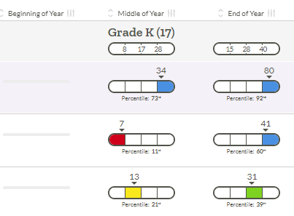
Grade K April Acadience Data - Nonsense Word Fluency-CLS
(Correct Letter Sounds)
January Data April Data
Well Below Benchmark - 37% (143 students) Well Below Benchmark - 32% (131 students)
Below Benchmark - 24% (94 students) Below Benchmark - 31% (126 students)
At Benchmark - 23% (90 students) At Benchmark - 20% (83 students)
Above Benchmark - 16% (61 students) Above Benchmark - 18% (73 students)
Notes:
Hernandez
Have teachers analyze and compare data from the beginning of the year and the middle of the year. Look at the above benchmark data from the beginning of the school year. What could have caused the decline?
I asked the questions above during the first round of data reviews. In this round of data review we have stopped the decline focusing on tier 1 instruction.
Children who have poorly developed phonemic awareness at the end of kindergarten are likely to become poor readers. Explicit instruction in sound identification, segmentation, and blending, when linked appropriately to sound-symbol association, reduces the risk of reading failure and accelerates early reading and spelling acquisition for all children.
Important Note: Cut points shifted from beginning of the year to mid year. Students were expected identify 10 first sounds in September to be considered on level, that shifted to 30 sounds at the mid-year assessment. Students won’t be assessed on the FSF directly in April, however, the nonsense word fluency assessment will allow the opportunity to determine student growth in this area.

Slide 46
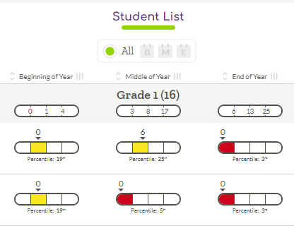
Grade 1 Acadience Data - Nonsense Word Fluency-WWR
September Data January Data April Data
Well Below Benchmark - 60% (244 students) Well Below Benchmark - 54% (207 students)
Below Benchmark - 67% (244 students) Below Benchmark - 13% (49 students) Below Benchmark - 22% (85 students)
At Benchmark - 17% (61 students) At Benchmark - 19% (69 students) At Benchmark - 15% (56 students)
Above Benchmark - 16% (57 students) Above Benchmark - 8% (30 students) Above Benchmark - 9% (36 students)
Notes:
Hernandez
Have teachers analyze and compare data from the beginning of the year and the middle of the year. What instructional strategies do you think can support students in making positive shifts in their skill acquisition? Look at the above benchmark data from the beginning of the school year. What could have caused the decline?

Slide 47
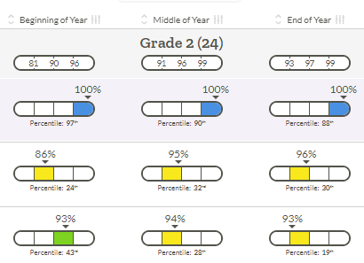
Grade 2 Acadience Data - Oral Reading Fluency - Accuracy
September Data January Data April Data
Well Below Benchmark - 51% (190 students) Well Below Benchmark - 53% (200 students) Well Below Benchmark -49 % (197 students)
Below Benchmark - 9% (32 students) Below Benchmark -8 % (31 students) Below Benchmark -7 % (29 students)
At Benchmark - 15% (55 students) At Benchmark - 11% (41 students) At Benchmark - 10% (41 students)
Above Benchmark - 26% (99 students) Above Benchmark -28 % (108 students) Above Benchmark -33 % (132 students)

Slide 48
Grades 3-8 Analyzing Your Building Data
What does this data tell me about where my students are towards reading and writing acquisition?
Steps to Accessing Your Data:
Log into HMH EdLearning
Go to Reports and select the Growth Measure 2022-2023
Select a grade level
Click on a class to access their individual scores
Notes:
Before beginning this piece take the teachers through Acadience and show the teacher how to access score for the whole class and how to narrow the data to individual student data. Show teachers how to look and interpret the scoring that was recorded. Example class will be used.

Slide 49
Points of Reflection Before Diving Into the Data
The Growth Measure is new and we are all learning how to analyze it together.
The Growth Measure data aligns with the New Jersey Student Learning Standards.
This diagnostic data allows us to analyze school, class and individual student data. Most importantly it affords us the opportunity to plan our instructional moves precisely.
The Growth Measure and the Benchmarks are key pieces of data that we must utilize to move our instruction forward.
Notes:
Hernandez-

Slide 50
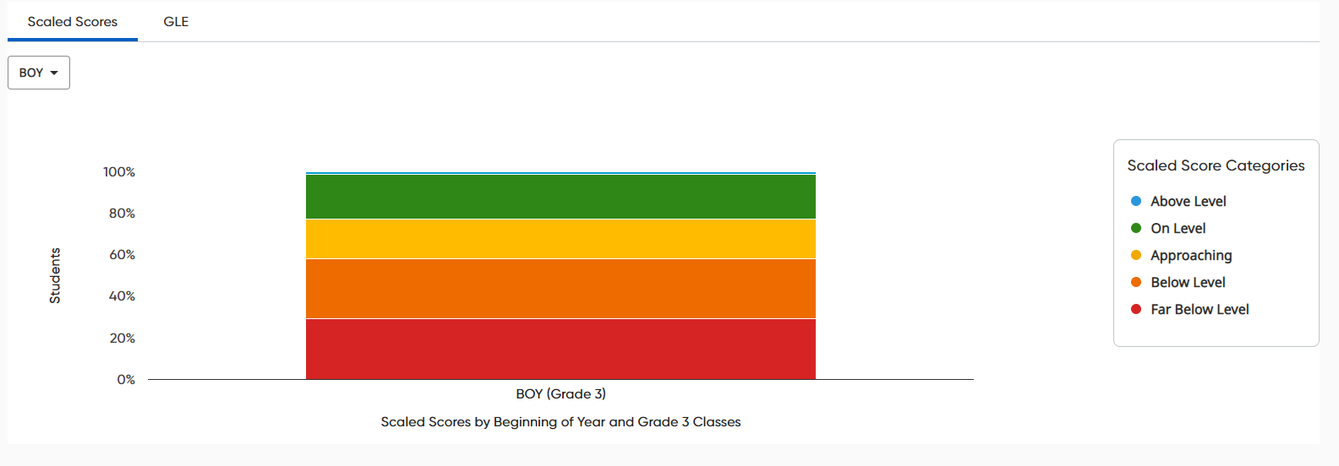
District
Performance Level | Percentage | # of Students
Above | 1.9% | 6
On | 19.7% | 62
Approaching | 28.3% | 89
Below | 26.7% | 84
Far Below | 23.5% | 74
Notes:
District

Slide 51
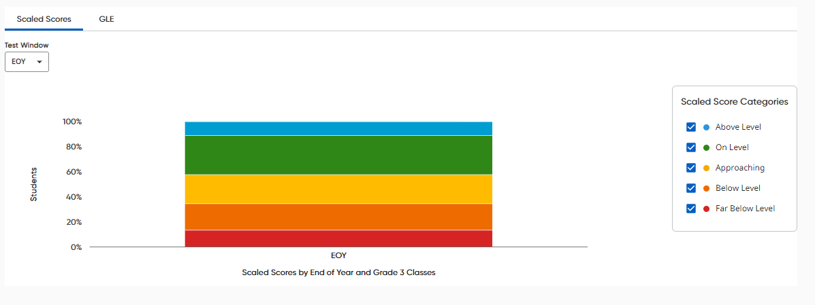
District
Performance Level | Percentage | # of Students
Above | 10.9% | 38
On | 31.1% | 109
Approaching | 23.4% | 82
Below | 21% | 74
Far Below | 13.4% | 47
Notes:
Change to EOY got to Growth Measure

Slide 52
Grade 3 - Growth Measure Data SY’ 2022-2023(in April)
Grade 3 | Total Ct | Ct On/Above Fall 2022 | % On/Above Fall 2022 | Ct On/Above Spring 2023 | % On/Above Spring 2023 | Ct Meeting Growth Goals | % of Students Meeting Growth Goals | Grade 3
Cleveland | 33 | 4 | 16% | 13 | 52% | 28 | 85% | Cleveland
Forest | 37 | 9 | 23% | 23 | 64% | 26 | 70% | Forest
Heywood | 37 | 12 | 32% | 25 | 68% | 32 | 86% | Heywood
Lincoln | 94 | 18 | 23% | 30 | 33% | 39 | 41% | Lincoln
Oakwood | 30 | 3 | 11% | 10 | 34% | 21 | 70% | Oakwood
Park | 43 | 7 | 18% | 10 | 27% | 15 | 35% | Park
Rosa Parks | 92 | 19 | 20% | 37 | 39% | 57 | 62% | Rosa Parks
total | 366 | 72 | 19% | 148 | 42% | 218 | 60% | total (218)

Slide 53
Grade 4 - Growth Measure Data SY’ 2022-2023(in April)
Grade 4 | Total Ct | Ct On/Above Fall 2022 | % On/Above Fall 2022 | Ct On/Above Spring 2023 | % On/Above Spring 2023 | Ct Meeting Growth Goals | % of Students Meeting Growth Goals | Grade 4
Cleveland | 39 | 12 | 35% | 16 | 50% | 21 | 54% | Cleveland
Forest | 45 | 12 | 20% | 20 | 47% | 25 | 56% | Forest
Heywood | 52 | 9 | 17% | 19 | 37% | 27 | 52% | Heywood
Lincoln | 90 | 7 | 9% | 18 | 21% | 30 | 33% | Lincoln
Oakwood | 26 | 5 | 20% | 8 | 31% | 17 | 65% | Oakwood
Park | 42 | 10 | 22% | 17 | 47% | 26 | 62% | Park
Rosa Parks | 121 | 27 | 24% | 52 | 44% | 54 | 45% | Rosa Parks
total | 415 | 82 | 21% | 150 | 38% | 200 | 56% | total (200)

Slide 54
Grade 5 - Growth Measure Data SY’ 2022-2023(in April)
Grade 5 | Total Ct | Ct On/Above Fall 2022 | % On/Above Fall 2022 | Ct On/Above Spring 2023 | % On/Above Spring 2023 | Ct Meeting Growth Goals | % of Students Meeting Growth Goals | Grade 5
Cleveland | 39 | 6 | 17% | 12 | 32% | 31 | 79% | Cleveland
Forest | 33 | 12 | 34% | 19 | 54% | 25 | 76% | Forest
Heywood | 43 | 15 | 35% | 18 | 40% | 19 | 44% | Heywood
Lincoln | 71 | 15 | 19% | 29 | 38% | 41 | 58% | Lincoln
Oakwood | 29 | 6 | 21% | 9 | 32% | 15 | 52% | Oakwood
Park | 49 | 4 | 11% | 11 | 24% | 23 | 49% | Park
Rosa Parks | 87 | 21 | 19% | 38 | 42% | 42 | 48% | Rosa Parks
total | 351 | 79 | 21% | 136 | 38% | 196 | 56% | total(196)

Slide 55
Grade 6 - Growth Measure Data SY’ 2022-2023(in April)
Grade 6 | Total Ct | Ct On/Above Fall 2022 | % On/Above Fall 2022 | Ct On/Above Spring 2023 | % On/Above Spring 2023 | Ct Meeting Growth Goals | % of Students Meeting Growth Goals | Grade 6
Cleveland | 49 | 2 | 5% | 9 | 20% | 16 | 33% | Cleveland
Forest | 32 | 10 | 25% | 17 | 47% | 18 | 56% | Forest
Heywood | 35 | 8 | 22% | 17 | 44% | 19 | 54% | Heywood
Lincoln | 87 | 14 | 15% | 32 | 37% | 54 | 62% | Lincoln
Oakwood | 37 | 6 | 25% | 4 | 15% | 18 | 49% | Oakwood
Park | 61 | 10 | 18% | 13 | 27% | 18 | 30% | Park
Rosa Parks | 99 | 13 | 13% | 21 | 20% | 40 | 40% | Rosa Parks
total | 400 | 63 | 17% | 113 | 29% | 183 | 46% | total(183)

Slide 56
Grade 7 - Growth Measure Data SY’ 2022-2023(in April)
Grade 7 | Total Ct | Ct On/Above Fall 2022 | % On/Above Fall 2022 | Ct On/Above Spring 2023 | % On/Above Spring 2023 | Ct Meeting Growth Goals | % of Students Meeting Growth Goals | Grade 7
Cleveland | 20 | 4 | 6% | 6 | 33% | 8 | 40% | Cleveland
Forest | 37 | 15 | 37% | 23 | 53% | 19 | 51% | Forest
Heywood | 32 | 12 | 40% | 21 | 68% | 20 | 63% | Heywood
Lincoln | 74 | 11 | 15% | 15 | 18% | 20 | 27% | Lincoln
Oakwood | 31 | 4 | 25% | 7 | 39% | 14 | 45% | Oakwood
Park | 43 | 6 | 15% | 7 | 18% | 11 | 26% | Park
Rosa Parks | 109 | 19 | 17% | 36 | 31% | 47 | 43% | Rosa Parks
total | 346 | 71 | 22% | 115 | 33% | 139 | 40% | total(139)

Slide 57
Grade 8 - Growth Measure Data SY’ 2022-2023 (in April)
Grade 8 | Ct On/Above Fall 2022 | % On/Above Fall 2022 | Ct On/Above Spring 2023 | % On/Above Spring 2023 | Ct Meeting Growth Goals | % of Students Meeting Growth Goals | Grade 8
OPA I&I | 86 | 22% | 141 | 35% | 181 | 45% | 403
EOY | Total Ct | Ct On/Above | % On/Above | Ct Met Growth Goals | % Met Growth Goals
Teacher 1 | 60 | 15 | 25% | 20 | 33%
Teacher 2 (ELL) | 62 | 2 | 3% | 20 | 44%
Teacher 3 (SWD) | 28 | 2 | 7% | 16 | 39%
Teacher 4 | 64 | 26 | 41% | 27 | 54%
Teacher 5 (Honors) | 65 | 48 | 74% | 39 | 62%
Teacher 6 | 67 | 32 | 48% | 40 | 58%
Teacher 7 | 57 | 16 | 28% | 19 | 35%

Slide 58
Benchmark
Student Writing - Where are the strengths and weaknesses (Class trends and individual students)
Let’s look at Grade 2

Slide 59
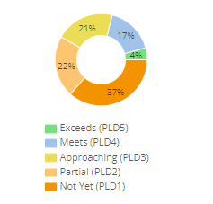
Benchmark Data from Module 2
Grade 8 - students
Prose Constructed Response
Frederick Douglass and Harriet Tubman were formerly enslaved human beings who became important leaders in the abolitionist movement. Compare and contrast the depictions of Harriet Tubman. How are they similar? How are they different? How does the primary source, Douglass' Letter, enhance readers understanding of Tubman's contribution to free the enslaved people in our country? Be sure to include evidence from both texts to support you response.
Most students were able to:
Differentiate the contributions of both leaders
generally reference and cull important information from the biographical text.
Students struggled to:
Use the primary source text in their explanations
support their findings with evidence from the primary source
write a fully elaborated essays that compare and contrast key details
Ct | %
16 | 4%
69 | 17%
85 | 21%
89 | 22%
148 | 37%
42%
Notes:
214/246 = 87% students submitted responses

Slide 60
Grade 8
Benchmark 3
EOY | Total Ct | Ct On/Above | % On/Above
Teacher 1 | 60 | 22 | 37%
Teacher 2 (ELL) | 63 | 15 | 23%
Teacher 3 (SWD) | 28 | 2 | 4%
Teacher 5 (Honors) | 66 | 64 | 97%
Teacher 6 | 67 | 43 | 64%
Teacher 7 | 59 | 25 | 42%

Slide 61
Benchmark Data from Module 2
Grade 9 - students
Prose Constructed Response
In Passage One, an excerpt from Ta-Nehisi Coates' Between the World and Me, and Passage Two, an excerpt from Ray Bradbury’s "The Pedestrian," the authors serve as observers of society. Write an essay that compares and contrasts what each observer learns about society and how they choose to reveal these observations to their audience. Be sure to include details of society and the individuals within society. Examine the author’s observations of society and individuals depicted in each work. Incorporate relevant evidence from each passage to support your reasoning. Explain the function and impact of specific details, figurative language, and other literary elements or techniques in each text.
Most students were able to:
recognize each observer’s depictions of society and/or individuals within society.
generally discuss each text in relation to the other.
Students struggled to:
explain the function/impact of specific details established by the author.
support their findings with evidence from each passage
write a fully elaborated essay that compares key details from both sources to support their ideas
Ct | %
29 | 15%
27 | 14%
33 | 17%
23 | 12%
82 | 42%
46%
Notes:
214/246 = 87% students submitted responses

Slide 62
Grade 9
Benchmark 2, Part 1
EOY | Total Ct | Ct On/Above | % On/Above
Teacher 1 | 90 | 21 | 23%
Teacher 2 (H) | 86 | 41 | 48%
Teacher 3 (ELL) | 14 | 3 | 21%
Teacher 4 (SWD) | 12 | 6 | 50%
Teacher 5 (SWD) | 15 | 7 | 47%
Benchmark 2, Part 2
EOY | Total Ct | Ct On/Above | % On/Above
Teacher 1 | 89 | 49 | 55%
Teacher 2 (H) | 67 | 37 | 55%
Teacher 3 (ELL) | 13 | 4 | 31%
Teacher 4 (SWD) | 12 | 24 | 27%
Teacher 5 (SWD) | 14 | 1 | 7%

Slide 63
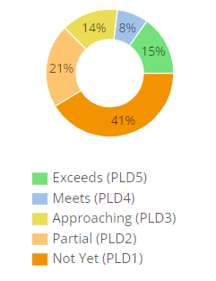
Benchmark Data from Module 2
Passage One: Excerpt from Death of a Salesman by Arthur Miller
Passage Two: “Scientists Reveal Three Keys to Happiness” by Lee Dye
Passage Three: “You Can buy Happiness If It Is An Experience” by Maanvi Singh
Revisit the conversation between Biff and Happy in Passage 1, an excerpt from Arthur Miller's Death of a Salesman, and examine how each character describes their view on happiness. Based on the claims made in Passage 2, Lee Dye's "Scientist Reveal Three Keys to Happiness," and Passage 3, Singh's "You Can Buy Happiness, If It's An Experience," write an essay determining which article would each brother most likely agree?
Examine each character's perspective on happiness.
Examine each author's claim about happiness in Passage Two and Passage Three.
With which article would each brother most likely agree?
Incorporate evidence from Passage One and at least one additional passage in your response to support your ideas.
Grade 10 - 264 students
Prose Constructed Response
Most students were able to:
identify the development of a central idea over the course of Passage One.
identify some key details to support the central idea of their selected passages.
Students struggled to:
accurately cite relevant and thorough evidence to support their claim.
write a fully elaborated essay that synthesizes ideas from Passage One and at least one additional passage to support their claim about perspectives on happiness.
Ct | %
40 | 15%
21 | 8%
38 | 14%
55 | 21%
108 | 41%
38%
Notes:
272/297= 92% students submitted responses

Slide 64
Grade 10
Benchmark 2, Part 1
EOY | Total Ct | Ct On/Above | % On/Above
Teacher 1 | 15 | 7 | 47%
Teacher 2 (ELL) | 24 | 13 | 54%
Teacher 3 | 15 | 10 | 67%
Teacher 4 | 15 | 10 | 67%
Teacher 5 (SWD) | 35 | 21 | 60%
Teacher 6 | 93 | 56 | 60%
Teacher 7 (H) | 78 | 47 | 60%
Benchmark 2, Part 2
EOY | Total Ct | Ct On/Above | % On/Above
Teacher 1 | 12 | 3 | 25%
Teacher 2 (ELL) | 24 | 14 | 58%
Teacher 3 | 15 | 10 | 67%
Teacher 4 | 15 | 4 | 27%
Teacher 5 (SWD) | 35 | 7 | 20%
Teacher 6 | 60 | 0 | 0%
Teacher 7 (H) | 79 | 37 | 47%

Slide 65
Benchmark Data from Module 2
Othello (I.III.8-72) by William Shakespeare
Othello (II.II.1087-1113) by William Shakespeare
"Of Envy" by Sir Francis Bacon
After reading Passage One and Passage Two, excerpts from Othello by William Shakespeare, and Passage Three, “Of Envy” by Sir Francis Bacon, write an essay explaining how Shakespeare’s depiction of Iago and his relationship with other characters embody Bacon’s thoughts on envy. Be sure to examine details of the envious as well as the envied in each passage.
Explore Bacon’s argument on envy, the envious, and the envied.
Examine the excerpts from Othello and apply Bacon’s argument to Shakespeare’s depiction of Iago and other characters.
Determine whether Shakespeare’s characters fit Bacon’s definition of envy.
Grade 12 - students
Prose Constructed Response
Most students were able to:
read closely to determine what is explicitly determined in passages one and two.
analyze the development of a central idea or theme.
summarize key supporting details and ideas.
Students struggled to:
make logical inferences and relevant connections between texts.
cite specific textual evidence from each passage to support conclusions drawn from the text.
write a fully elaborated essay that provides insight and commentary on how ideas are developed across multiple texts.
Ct | %
19 | 12%
12 | 8%
33 | 21%
14 | 9%
77 | 50%
41%
Notes:
182/188+ 97% students submitted responses

Slide 66
Grade 12
Benchmark 2, Part 1
EOY | Total Ct | Ct On/Above | % On/Above
Teacher 1 | 35 | 22 | 63%
Teacher 2 (ELL) | 32 | 7 | 22%
Teacher 3 | 90 | 40 | 44%
Teacher 4 (SWD) | 6 | 1 | 17%
Teacher (SWD) | 12 | 5 | 42%
Benchmark 2, Part 2
EOY | Total Ct | Ct On/Above | % On/Above
Teacher 1 | 28 | 24 | 86%
Teacher 2 (ELL) | 30 | 12 | 40%
Teacher 3 | 80 | 29 | 36%
Teacher 4 (SWD) | 6 | 0 | 0%
Teacher (SWD) | 11 | 0 | 0%

Slide 67
Let’s Dig Deeper…
Go
Go to the Growth Measure
View
View class breakdown
Identify students in buckets based upon reading subscore (You can create groupings here)
Now go to Class Reports and select Standards Report
Go
Go to the Standards Report
Identify students to see where they were successful and where they stumbled
Review the Skills Breakdown for the module

Slide 68
Thoughts about the Data
Let’s look at the Approaching bucket
Are students stronger in Reading Information or Literature?
Key Ideas and Details? Standards 1-3
Craft and Structure? Standards 4-7
Integration of Ideas? Standards 8 & 9 - Benchmark data
Notes:
Notes will be taken as the presenters are circulating and assisting teachers with analyzing their class data.

Slide 69
Let’s look ahead. How will you use the remainder of the school year?
Which students are performing below grade level?
What is the plan to accelerate them from now to end of the school year? During the summer?
How will you monitor their progress? (Acadience - Growth Measure?)
Where are teachers with pacing? The remainder of the year is preparation for next year.
Is it through…
Whole group modifications
Small group targeted instruction and practice
Opportunities for practice application
Notes:
Share the plan for Below grade level performers in grades K-2.
Invite schools to use Growth Measure to re-assess students in June

Slide 70
Attendance Presentation from the Month of May 2023
Gerald Fitzhugh, II, Ed.D.
Superintendent of Schools
“ The Teaching Superintendent”
June 14, 2023
Focus Core Area Number 1-4
District Goal Number 1-4

Slide 71
Absences Category | Cumulative Days Absent for the Month of May 2023
Low Chronic Absences | 0 to 4.99 days
Modest Chronic Absences | 5 to 10.99 days
Significant Chronic Absences | 11 to 16.99 days
High Chronic Absences | 17 days or more
*Students are chronically absent when excused or unexcused absences are equal to or greater than 10% of the total number of days enrolled in the school year.
Chronically Absence Categories are Identified As:

Slide 72
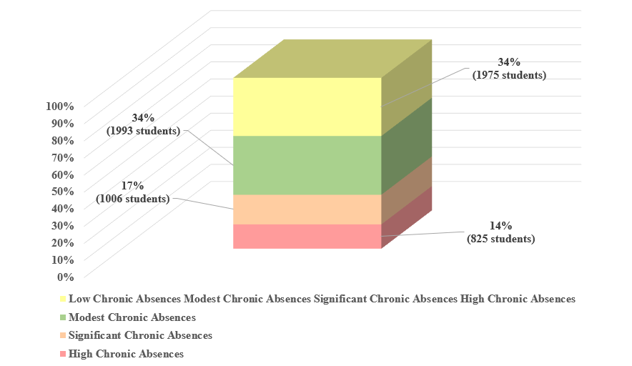
Cumulative Absences for the Month of May
by Category

Slide 73
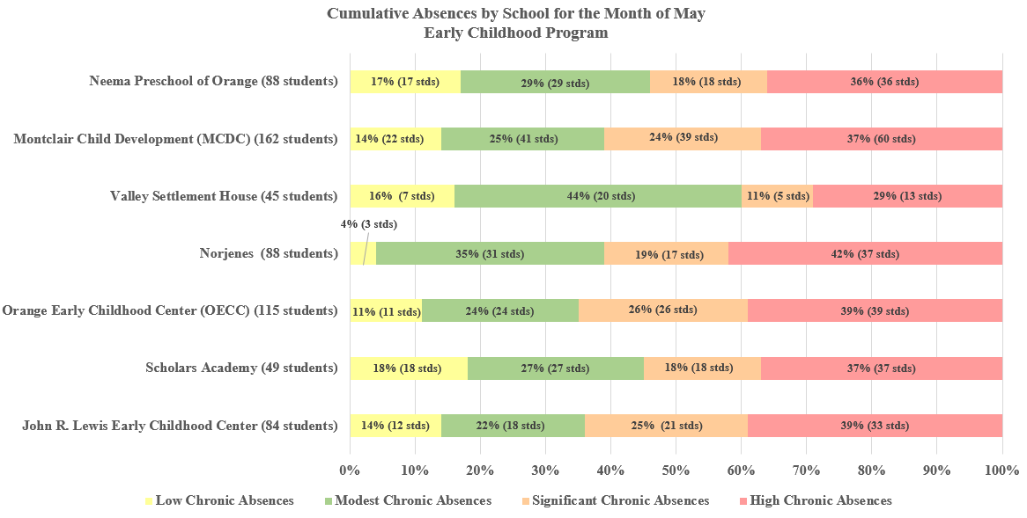

Slide 74
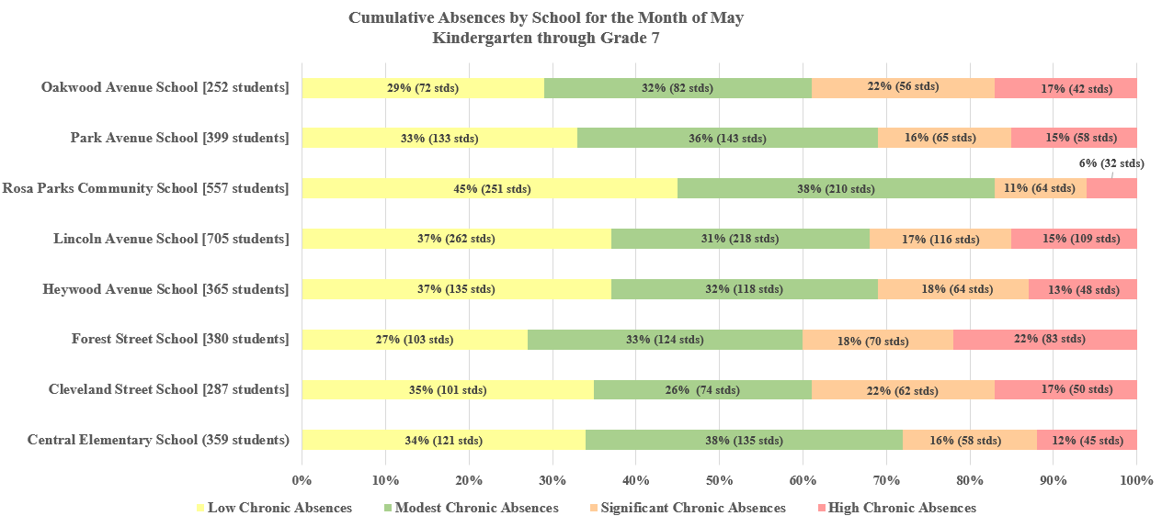

Slide 75
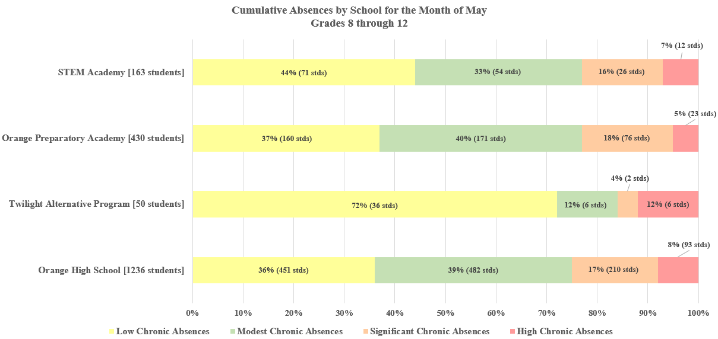

Slide 76
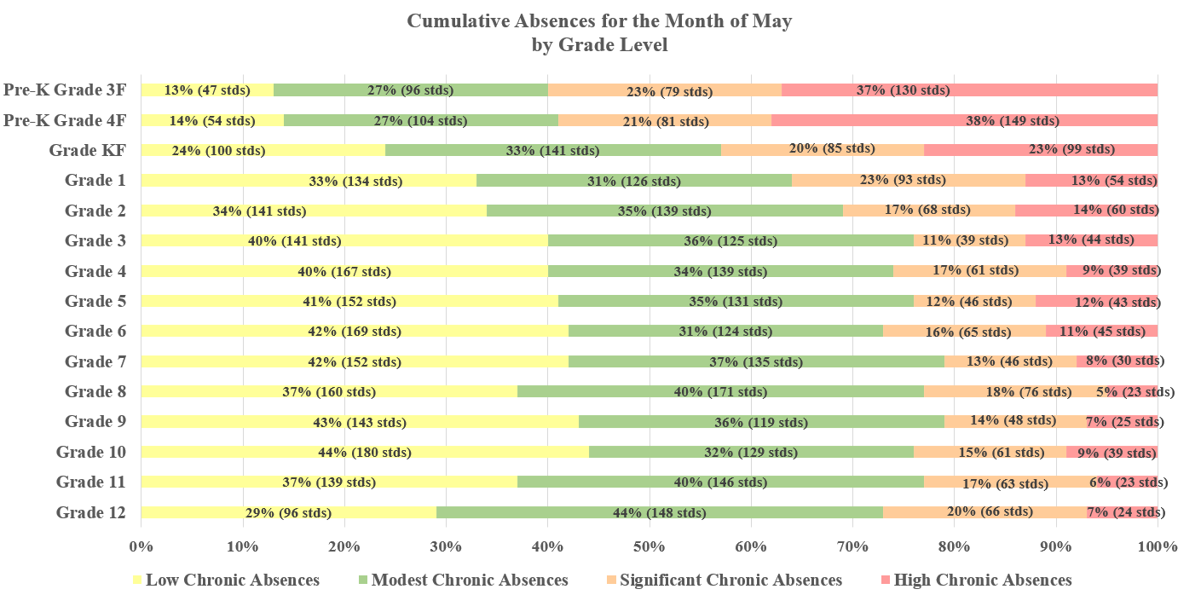

Slide 77
May 2023 Average Daily Attendance Percentages *State Average is 95% District Average Daily Attendance was 96%

Slide 78
Reminder: The Orange App Have you signed up? You know I am sending blasts out for folks to sign up…Stay Tuned

Slide 79
Orange Public Schools Social Media
Social Media Hashtags:
#GoodtoGreat
#MovingintoGreatness
#OrangeStrong
Follow us:
- Orange Public School District
- @ops_district
- opsdistrict
- Orange Public School District

